Slide 1
Pokemon CNN Classifier
By Dylan Louie

Slide 2


What your project is and how it fits with the theme
Back to Square (Gen) One!!!

Slide 3

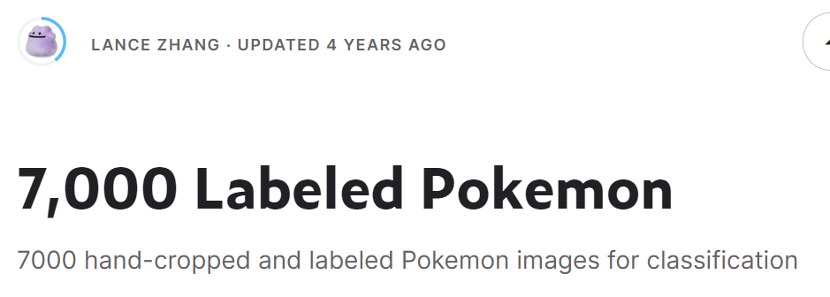
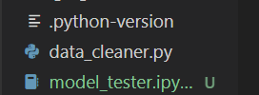
The data you used (how it was processed, how you found it, etc)
https://www.kaggle.com/datasets/thedagger/pokemon-generation-one
https://www.kaggle.com/datasets/lantian773030/pokemonclassification/data
“data_cleaner.py” is the file to run to clean the dataset
converts SVG images (with `cairosvg`) to PNG
converts all images to RGB format (with `PIL`)
converts images to tensors (with `torch`)
resizes all images to 100 * 1oo (with `torch`)
inserts all images into a dataframe with one hot encoded labels (with `Pandas`)
saves the Data Frame into a .pkl file (with `Pandas`)

Slide 4
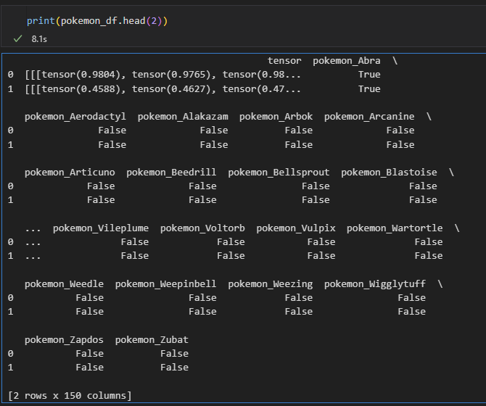
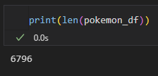
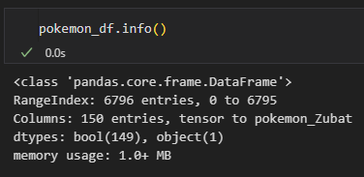
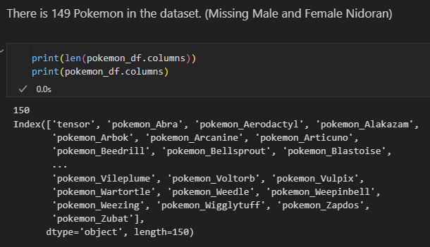
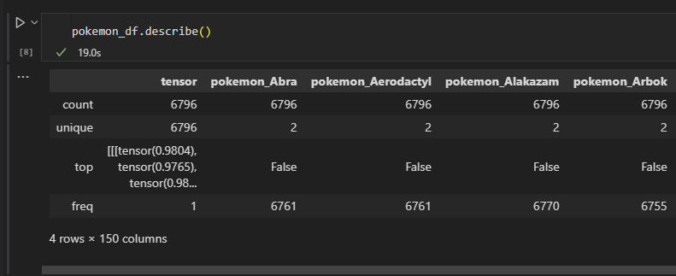
The Pandas Data Frame

Slide 5
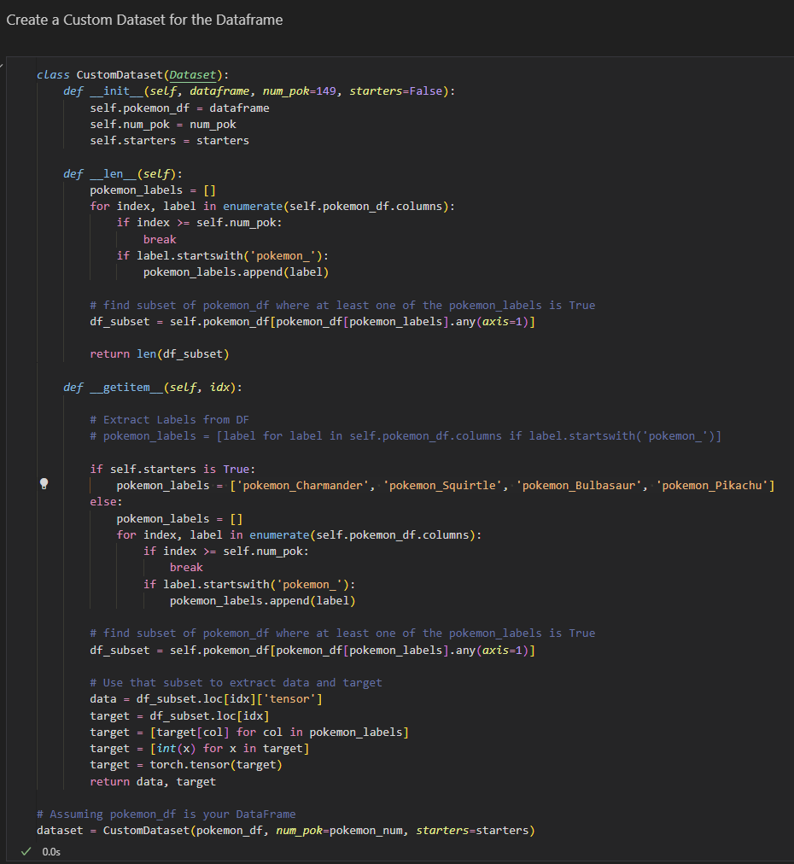
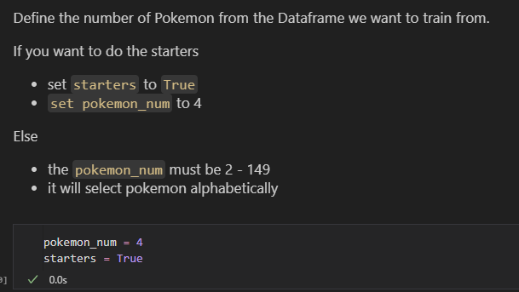
CustOM DATASeT

Slide 6
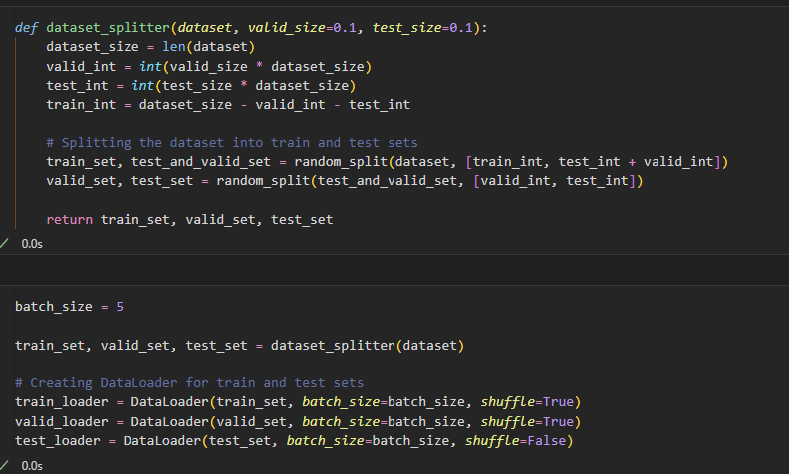
CustOM DATASeT: Split INto Train, Valid, and TEst

Slide 7
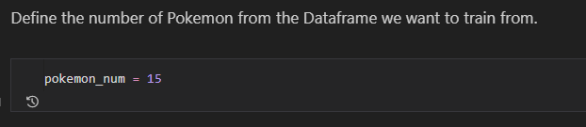
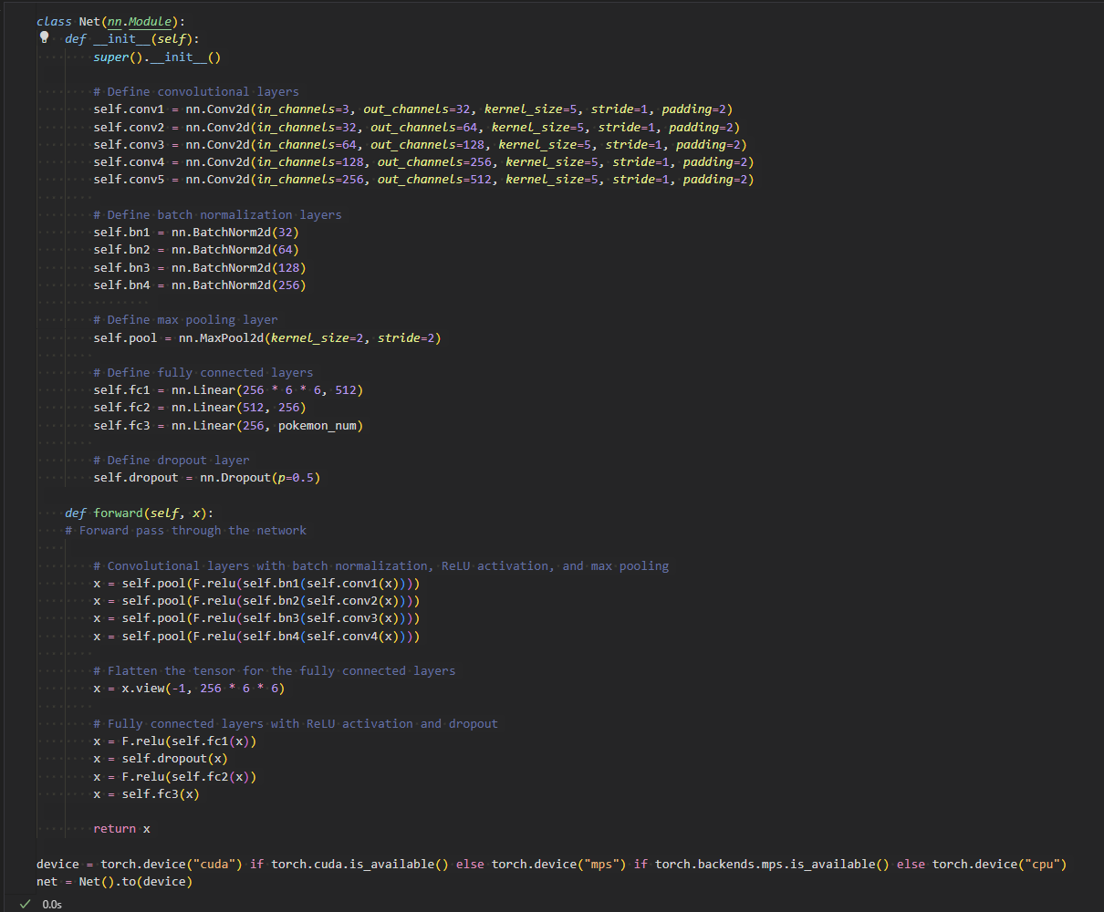
What model you used/what architecture does it have/why you chose that etc. etc.
C32-M-C64-M-C128-M-C256-M-C512-M-F(256 * 6 * 6, 512)-D-F(512, 256)-F(256, pokemon_num)
Chose to create a CNN because this is an image dataset
Honestly just experimented with different number of layers to find better accuracy
Final layer output size is “pokemon_num” which is the number of pokemon you train off of from the dataset. Even though 7000 images sounds like a lot. Each Pokemon only has 25 - 50 images only. 7000 / 149 ~ 47. 1/149 ~ 0.0067. Essentially if you want to see a good amount of accuracy I would set it to 2 - 15 Pokemon. The less pokemon the better the accuracy.

Slide 8
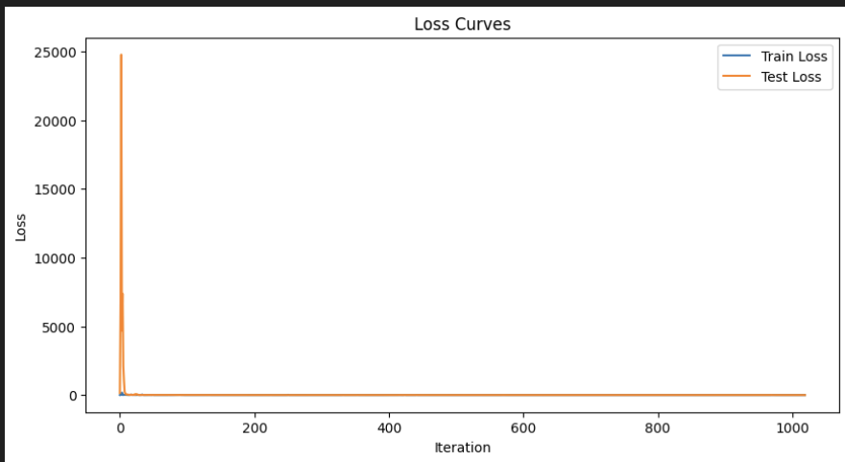
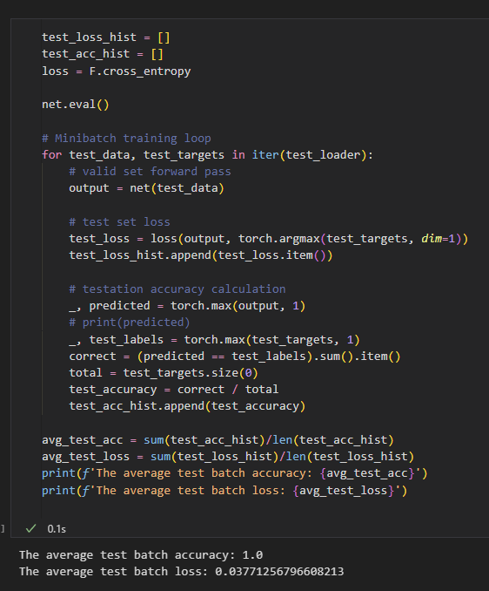
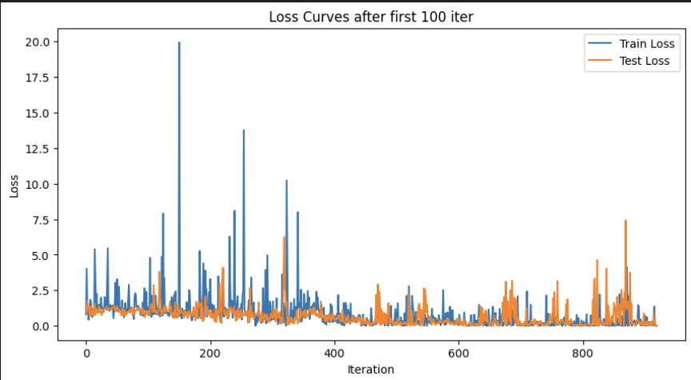
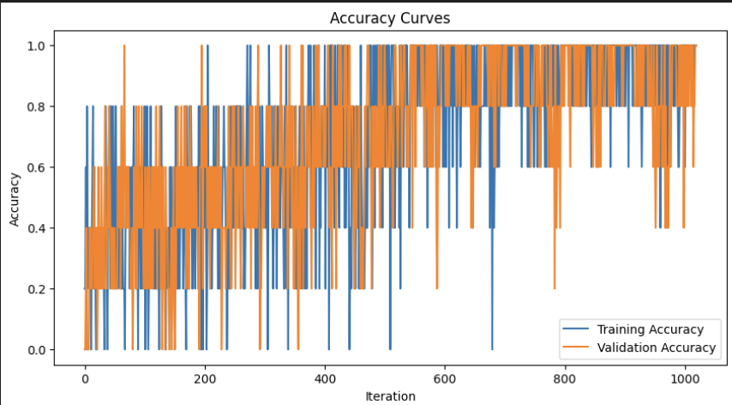
Results (Starters)

Slide 9
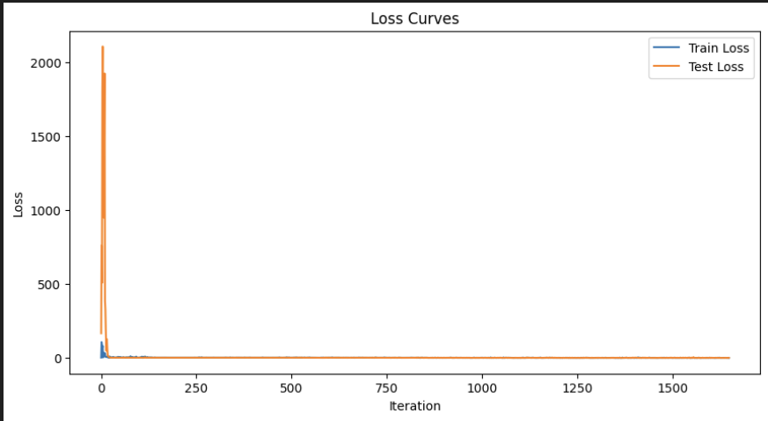
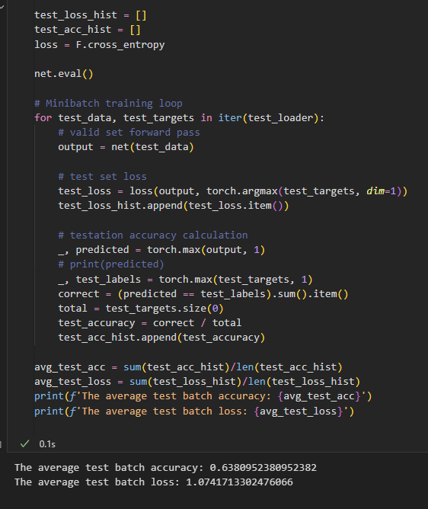
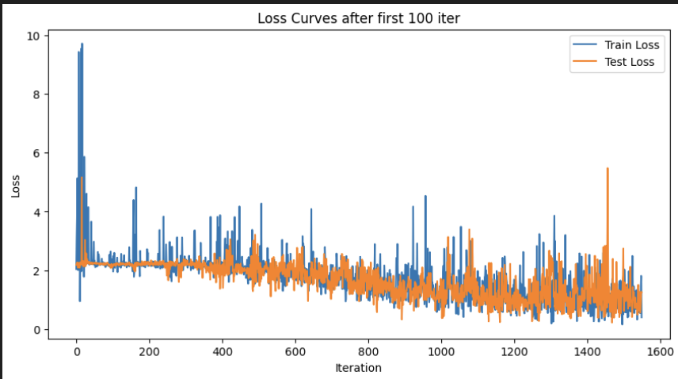
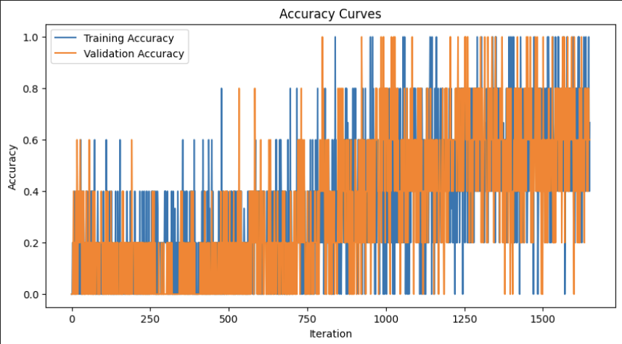
Results (10 Pokemon)

Slide 10
Possible issues with your model/roadblocks you had to overcome
Learning how to transform the images into tensors and putting them into a Data Frame
Funny story, for a while I thought it was just taking 10’s of minutes to do because it was a lot of images; but really it was because I was printing the Data Frame which takes a while.
Learning how to make a custom Data Set with Torch
Learning how to make a PyTorch CNN
https://pytorch.org/tutorials/beginner/blitz/cifar10_tutorial.html
https://snntorch.readthedocs.io/en/latest/tutorials/index.html
Learning how to feed one hot encoded labels into a torch CNN
Small amount of data for each Pokemon/Label. 7000 images, but only 25-60 per Pokemon. Large amount of Pokemon also means its very hard to get a high accuracy.

Slide 11
Possible Future improvements if you had more time/resources (or future plans if you plan to continue working on it)
Run the model on the Pokemon RAP
https://youtu.be/xMk8wuw7nek?si=g7Qo49rJKbqjgtR4
Have the model spit out the corresponding Pokedex description
Use Resnet 18 model for potentially better accuracy
https://pytorch.org/vision/main/models/generated/torchvision.models.resnet18.html

Slide 12

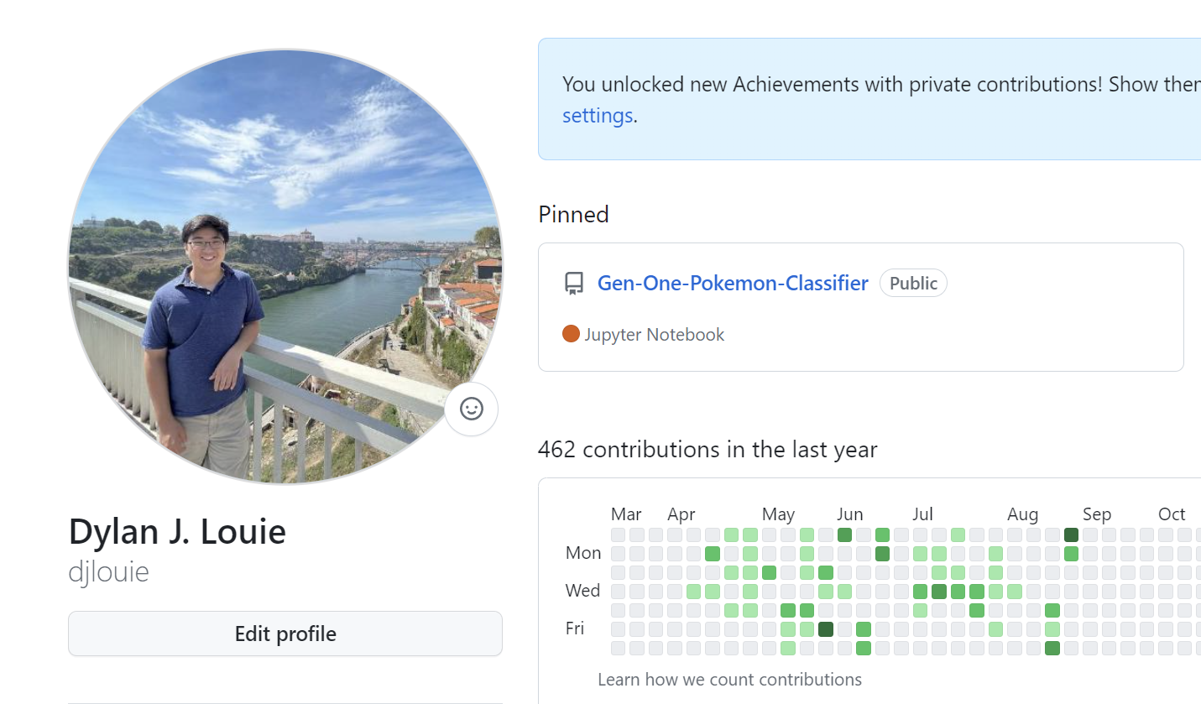
Anything else about your process that was interesting / unique: STarter PoKEDEX?! & Only Pinned Repo?!
GitHub Repo:
https://github.com/djlouie/Gen-One-Pokemon-Classifier
Follow Me
www.linkedin.com/in/dylanlouie
https://github.com/djlouie

